Slide 1
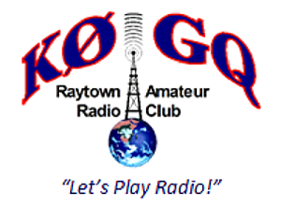
Amateur Radio
An Overview Presentation
This presentation is a very high level overview of Amateur Radio, presented by the Raytown Amateur Radio Club, Inc. to the Raytown Public Schools.
Version 1.01, September 2016
Copyright © 2016 Raytown Amateur Radio Club, Inc.

Slide 2
Amateur Radio - Definition
The Long Answer:
Amateur radio (also called ham radio) describes the use of radio frequency spectrum for purposes of non-commercial exchange of messages, wireless experimentation, self-training, private recreation, radio sport, contesting, and emergency communication. The term "amateur" is used to specify "a duly authorized person interested in radio-electric practice with a purely personal aim and without pecuniary interest;" (either direct monetary or other similar reward) and to differentiate it from commercial broadcasting, public safety (such as police and fire), or professional two-way radio services (such as maritime, aviation, taxis, etc.)
Amateur Radio Service in this context means that persons involved are not paid for their services or skills, as opposed to the Professional Radio Service such as public safety, maritime, public safety, etc. where those involved are paid for their services.

Slide 3
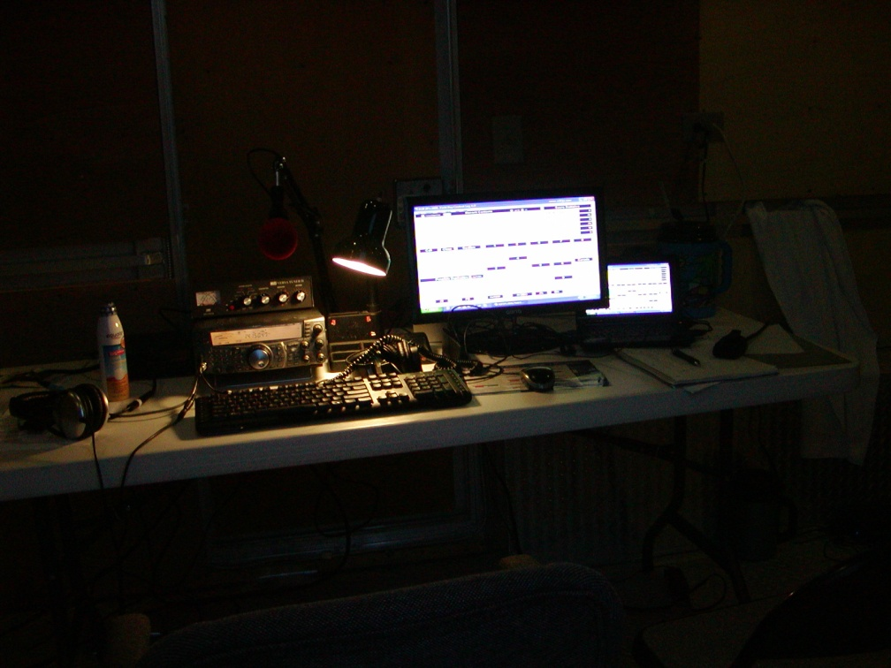
Amateur Radio - Definition
Simply Stated:
We are skilled individuals and groups, who are interested in electronic communications, and are licensed to pursue our interests on certain radio bands for enjoyment, recreation, education, and public service.

Slide 4

Amateur Radio – License Requirements
Authority:
The radio spectrum, being a public resource, are managed and regulated by the Federal Communications Commission (FCC) of the United States. The FCC through their regulations issue licenses to stations, organizations, and individuals for the various radio services available. Part 95 of the FCC Rules and Regulations govern the Amateur Radio Service.

Slide 5
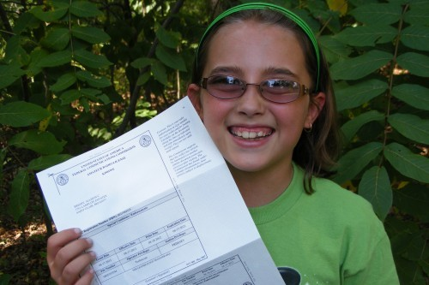
Amateur Radio – License Requirements
The Amateur Radio License:
There are three levels of license presently available in the United States in the Amateur Radio Service. Each higher level of license allows the holder additional privileges, capabilities, and available radio spectrum use.

Slide 6
Amateur Radio – License Requirements
Technician Class:
The Technician class license is the entry-level license of choice for most new ham radio operators. To earn the Technician license requires passing one examination totaling 35 questions on radio theory, regulations and operating practices. The license gives access to all Amateur Radio frequencies above 30 megahertz, allowing these licensees the ability to communicate locally and most often within North America. It also allows for some limited privileges on the HF (also called "short wave") bands used for international communications. Operators within this class are eligible to work Satellite Communications.

Slide 7
Amateur Radio – License Requirements
General Class:
The General class license grants some operating privileges on all Amateur Radio bands and all operating modes. This license opens the door to world-wide communications. Earning the General class license requires passing a 35 question examination. General class licensees must also have passed the Technician written examination.

Slide 8
Amateur Radio – License Requirements
Amateur Extra Class:
This highest class of Amateur Radio License. The Amateur Extra class license conveys all available U.S. Amateur Radio operating privileges on all bands and all modes. Earning the license is more difficult; it requires passing a thorough 50 question examination. Extra class licensees must also have passed all previous license class written examinations.

Slide 9
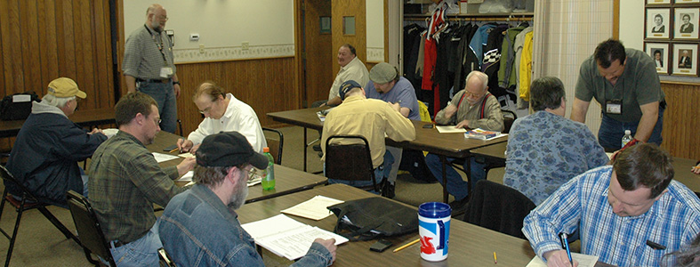
Amateur Radio – License Requirements
Don’t Freak Out!
While it is encouraged that all amateur radio operators strive to achieve the highest grade of license, the Technician Class License meets the minimum requirements to work within the area allocated for Satellite Communications.

Slide 10
Amateur Radio – License Study
To Obtain a License Requires Effort, But There Are Options:
Any person of any age who is self disciplined, and has good study habits is capable of picking up a study guide, taking the on-line practice tests, and then taking and passing the formal license test. However, there are other options available.
Join a Study Group moderated by an experienced ham radio operator. (Hams who mentor other Hams are known as “Elmers”.)
Enroll in a Weekend License Boot Camp. These two day sessions provide study material, training, and testing at the end of the session.

Slide 11

Amateur Radio – Your Call Sign
A Quick Word About Call Signs:
An FCC Issued Call Sign is the unique identifier for your radio and/or station license.
The US is divided into Ten Zones, each identified with the numeral One through Zero to identify the zone where the license was issued. Your call will contain a Ø!
Missouri and Kansas are in Zone Ø. You’ll note that the Zero has a ‘slash’ through it to denote the difference between the Numeral Zero, as opposed to the Letter ‘O’. The Ham Operators in the Midwest have become very proud of our unique display of Ø and have carried on this tradition.

Slide 12

Amateur Radio – Satellite Communications
A Short History:
OSCAR 1, the 1st Amateur Radio Satellite
OSCAR: Orbiting Satellite Carrying Amateur Radio
Project OSCAR started in 1960 and was responsible for the construction of the first Amateur Radio Satellite OSCAR-1 that was successfully launched from Vandenberg AFB in California, on December 12, 1961, barely four years after the launch of Russia’s first Sputnik. OSCAR-1 orbited the earth for 22 days, transmitting the “HI” greeting in Morse Code from above.

Slide 13
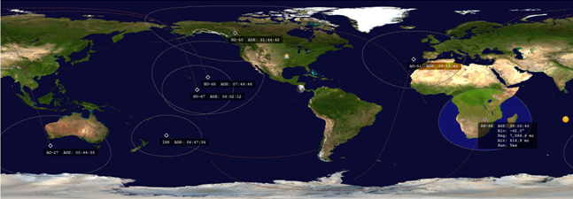
Amateur Radio – Satellite Communications
A Slightly Technical Overview:
Satellite communications are “Line of Sight”
You do not need very much power to work Amateur Radio Satellites.
Split band communications recommended, i.e. VHF Uplink / UHF Downlink.
Communications occurs only when the operating station is within the radio ‘Footprint’ of the orbiting satellite.

Slide 14
Amateur Radio – Satellite Communications
Most Basic Hardware Setup:
Radio
  5 Watt (or less) Split-Band, Hand Held HT Radio
Antenna
  Hand Held Yagi Antenna, or
  After Market HT Whip
Voice Recorder
  Digital or Tape Recorder
Satellite Prediction Software
  For PC Computer:
  For PDA Running or Smart Phone
A Simple Compass

Slide 15
Amateur Radio – Satellite Communications
Recommended Amateur Radio Bands:
The bands recommended for satellite communications include the
  2m VHF Band,
  70cm UHF Band
  Microware Bands in the Gigahertz Range.
Each band has its own unique pros and cons.
With respect to economically priced and available hardware, the VHF and / or UHF Bands are recommended.

Slide 16
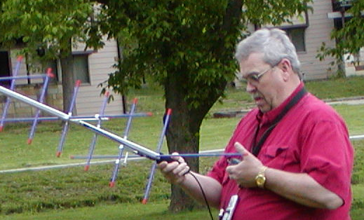
Amateur Radio – Satellite Communications
We Have More Details on Satellite Communications!
We have an entire presentation which provides more details on Satellite Communications. This presentation typically includes a hands on demonstration of working an actual Amateur Radio Satellite in space.

Slide 17
Amateur Radio – Other Hardware Considerations for Other Activities
Amateur Radio has something for everyone:
Antenna Theory
Automatic Link Establishment
Automatic Packet Reporting System
Contesting
Direction finding
DX communication
DX-pedition
Emergency communications
Hamfest
High Speed Multimedia
High Speed Telegraphy
Homebrew
Internet Radio Linking Project
Operating Awards
Packet Radio
Portable Operation
QRP Operation
QSL Card
Satellite and Space Communications
Skywarn
Special Event Stations
Amateur Radio Television
Vintage radios
Just to Name a Few!

Slide 18
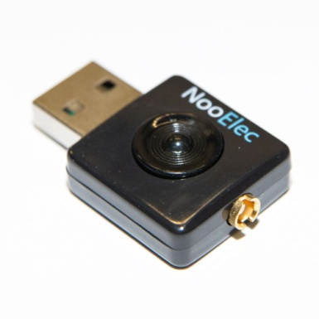
Amateur Radio – Other Hardware Considerations for Other Activities
To meet the needs for the activity that interests you most, you have many choices:
Small and Large

Slide 19
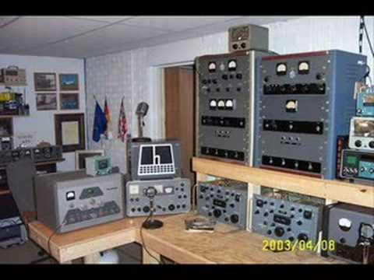
Amateur Radio – Other Hardware Considerations for Other Activities
To meet the needs for the activity that interests you most, you have many choices:
Small and Large

Slide 20
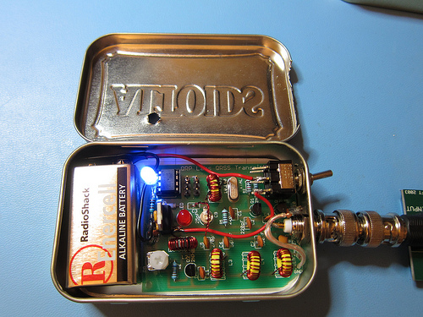
Amateur Radio – Other Hardware Considerations for Other Activities
To meet the needs for the activity that interests you most, you have many choices:
Simple or Complex

Slide 21
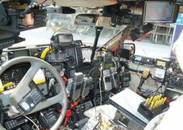
Amateur Radio – Other Hardware Considerations for Other Activities
To meet the needs for the activity that interests you most, you have many choices:
Simple or Complex

Slide 22
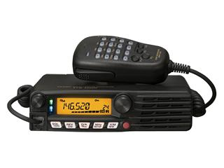
Amateur Radio – Other Hardware Considerations for Other Activities
To meet the needs for the activity that interests you most, you have many choices:
Single Purpose or Multi Mode

Slide 23
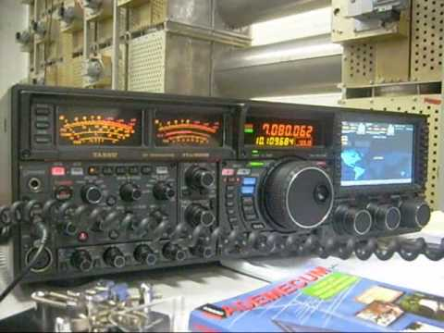
Amateur Radio – Other Hardware Considerations for Other Activities
To meet the needs for the activity that interests you most, you have many choices:
Single Purpose or Multi Mode

Slide 24
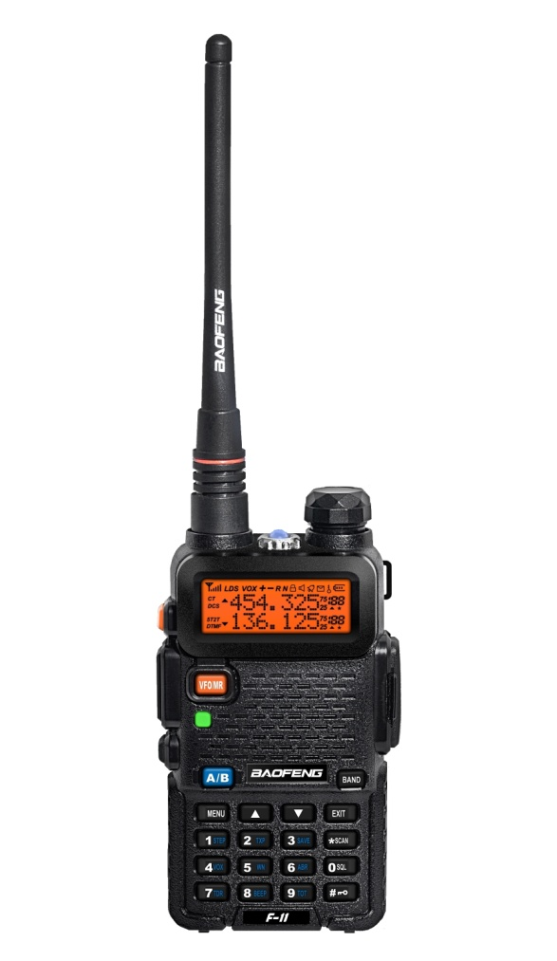
Amateur Radio – Other Hardware Considerations for Other Activities
To meet the needs for the activity that interests you most, you have many choices:
Inexpensive or Really Expensive

Slide 25
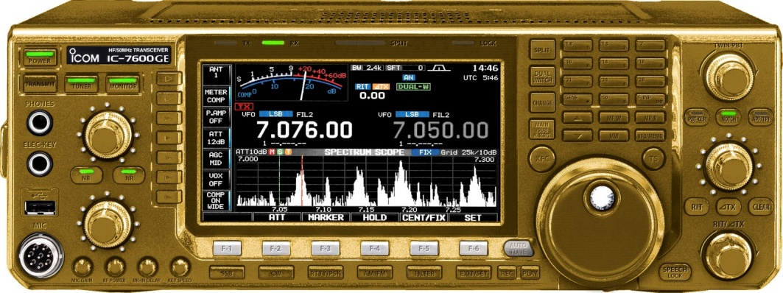
Amateur Radio – Other Hardware Considerations for Other Activities
To meet the needs for the activity that interests you most, you have many choices:
Inexpensive or Really Expensive

Slide 26
Amateur Radio – The Bottom Line
Radio Operations is a skill that is learned and acquired. It’s not as simple as pressing a button, and getting results. It’s a matter of understanding, and bringing a number of concepts together to provide a desired outcome.
If you’re a curious individual, the enjoyment can come from what you learn and how you apply that knowledge toward what you can accomplish.
You can invest as much or as little as you want toward an end result. Sometimes, immense satisfaction comes from doing something very amazing using your brains and skills, instead of merely throwing money and material at a problem.

Slide 27
Amateur Radio – The Bottom Line
Start Small
and
Dream BIG!

Slide 28
Amateur Radio
Q&A

