Slide 1
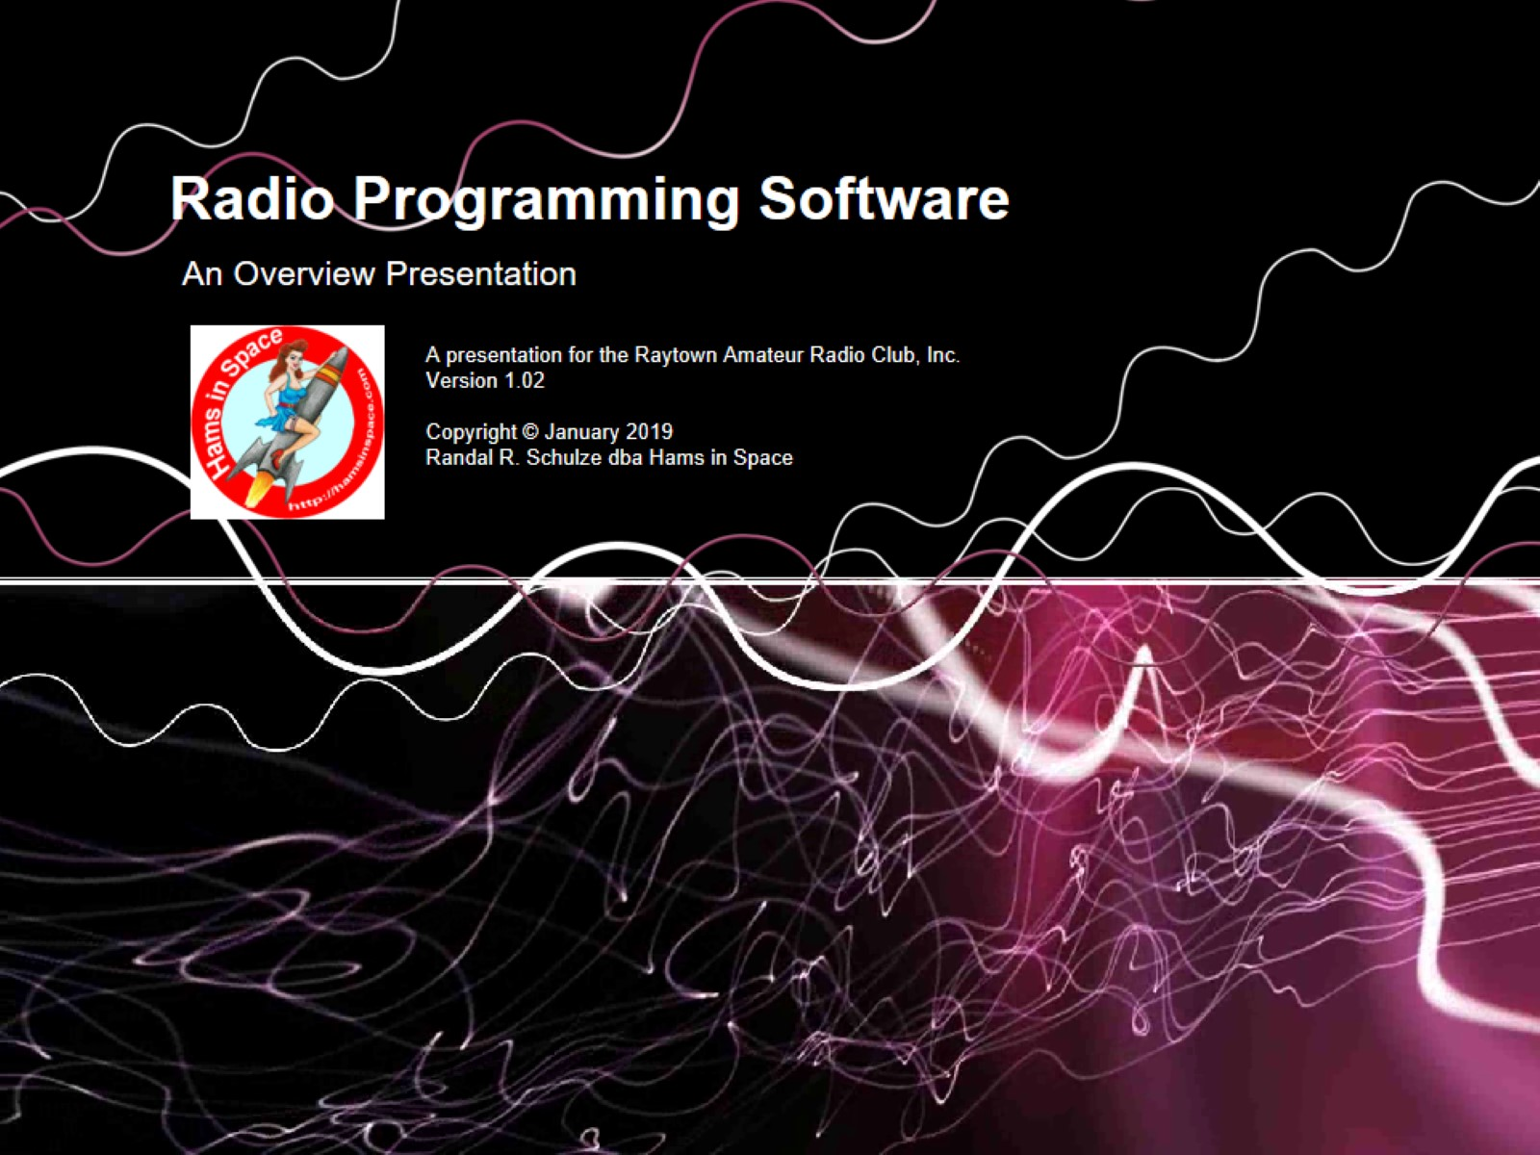
Radio Programming Software

Slide 2
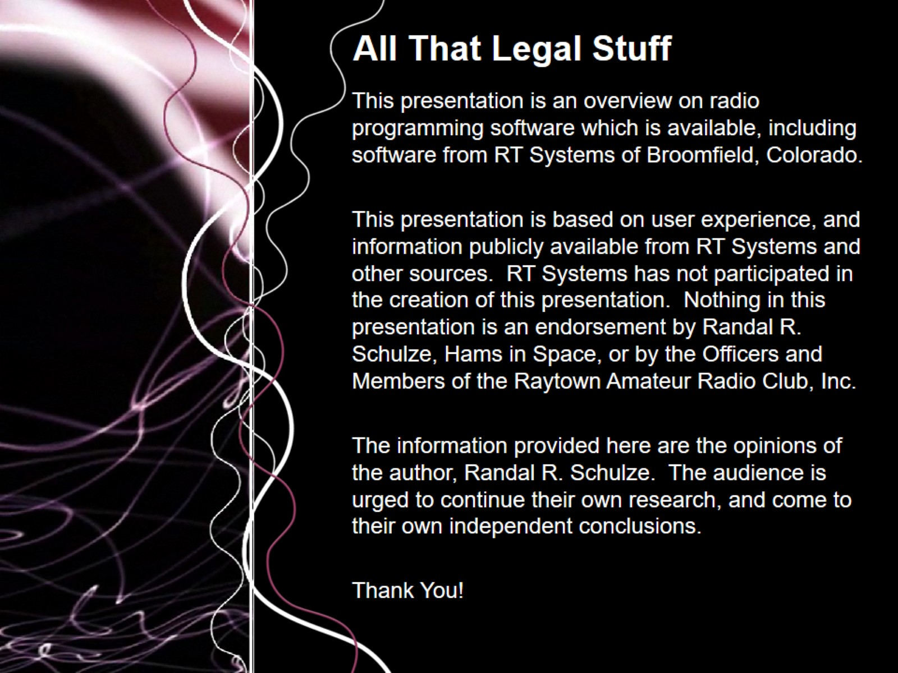
All That Legal Stuff

Slide 3
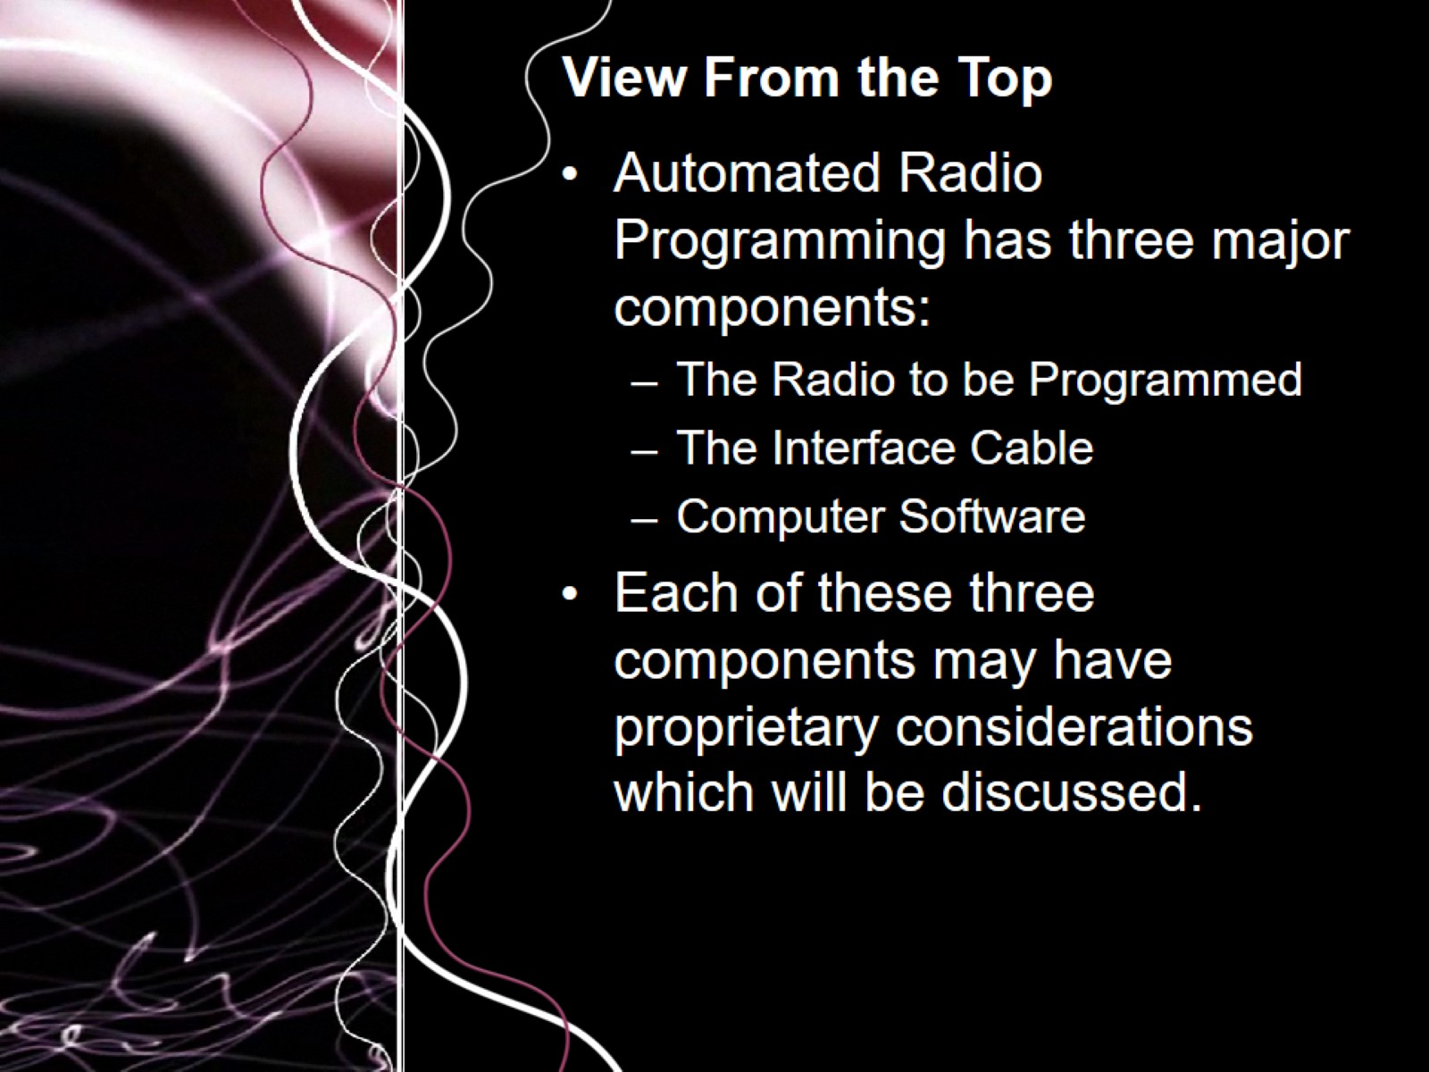
View From the Top

Slide 4
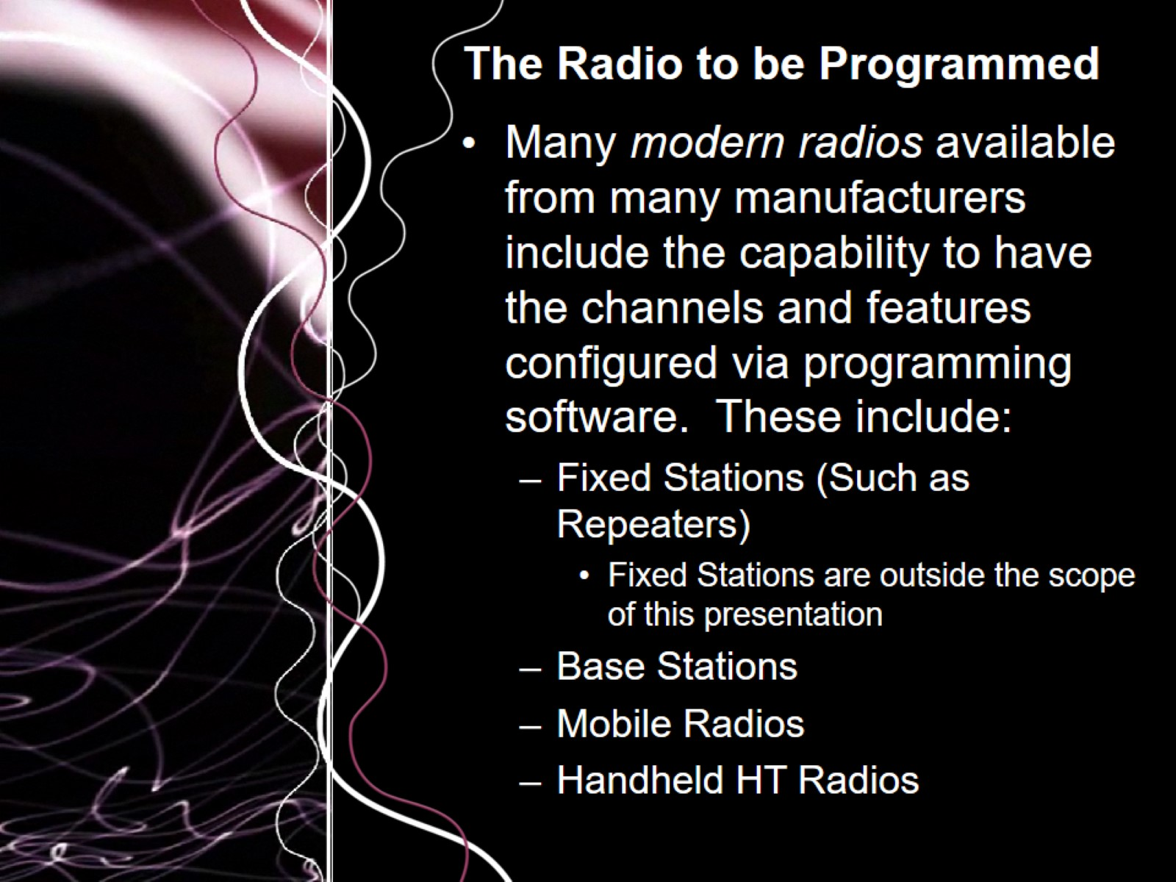
The Radio to be Programmed

Slide 5
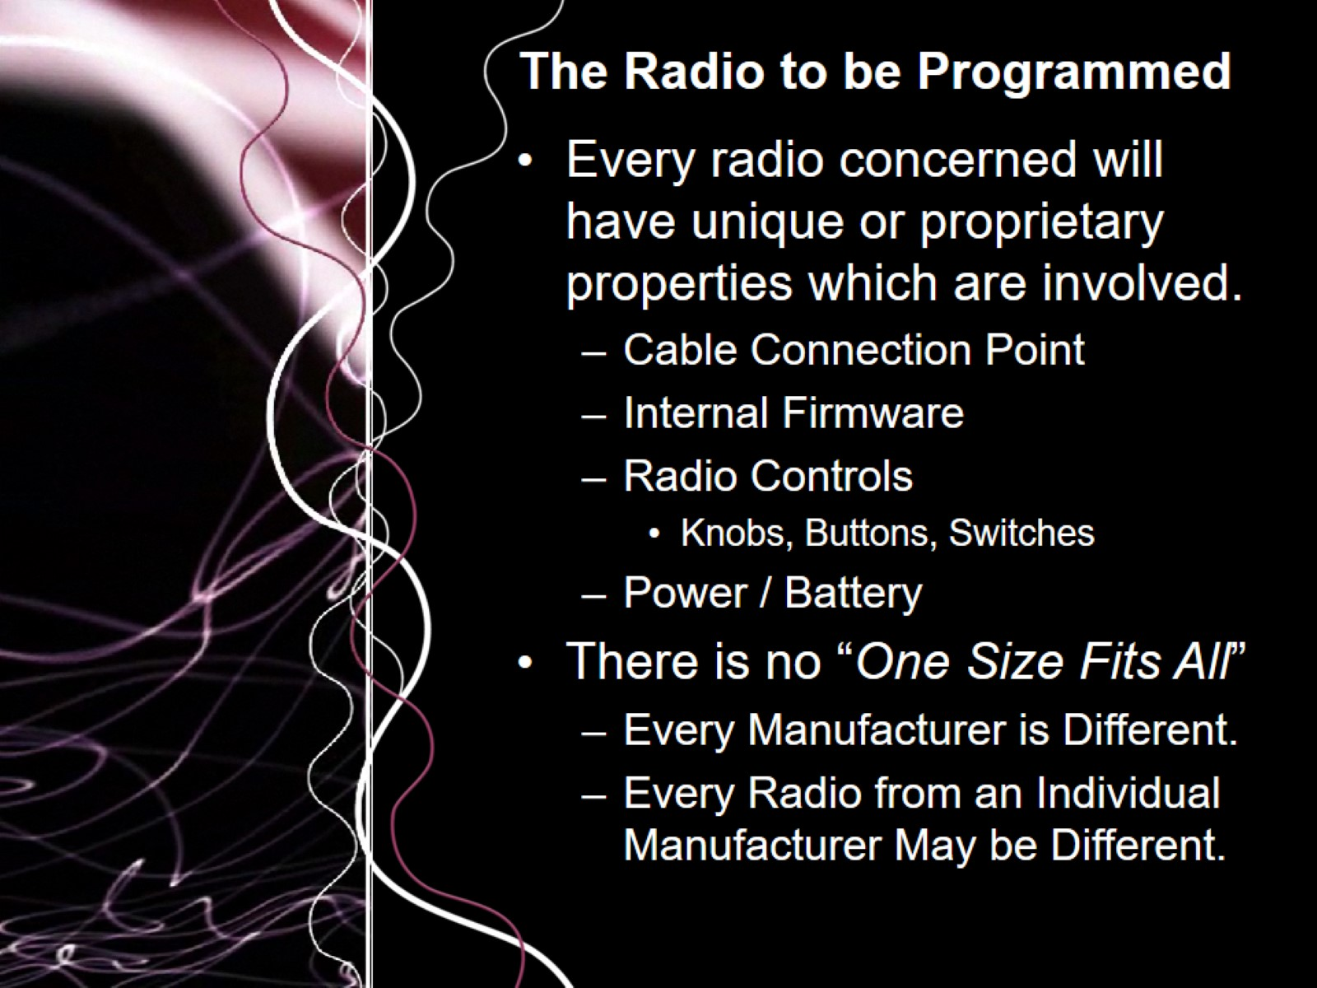
The Radio to be Programmed

Slide 6
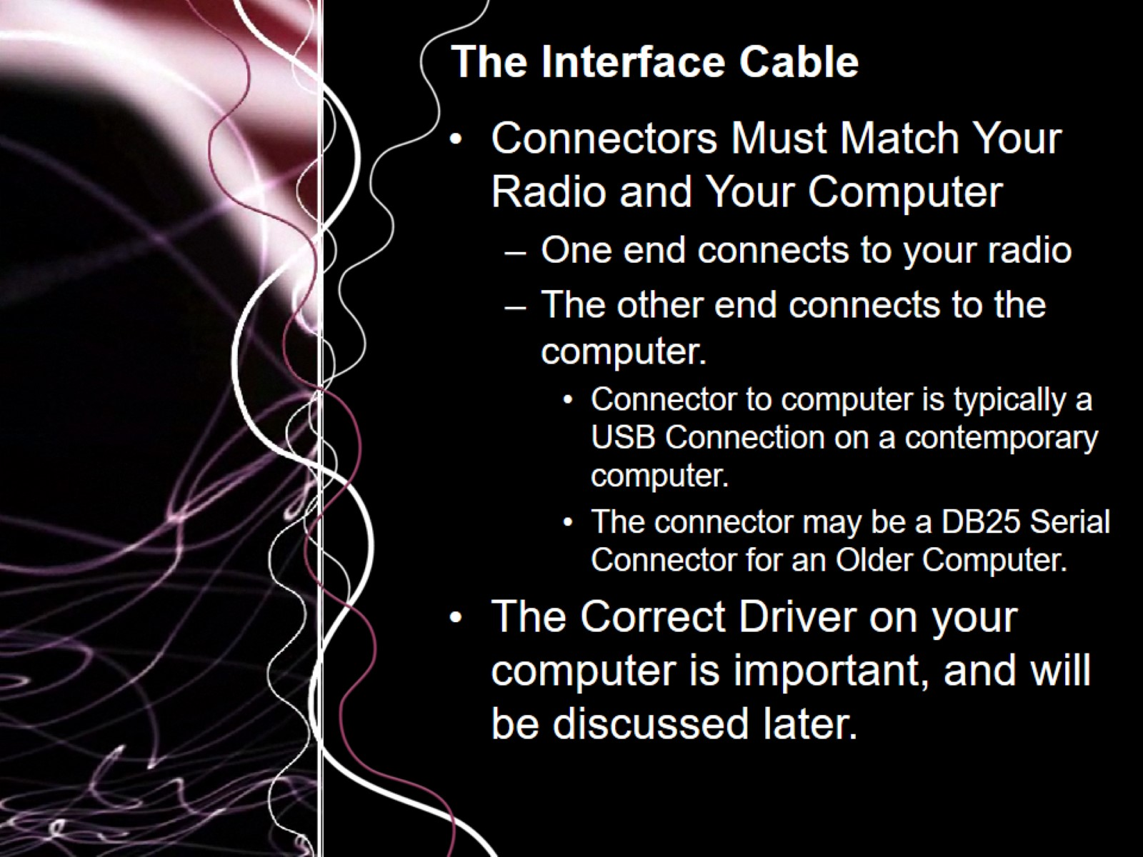
The Interface Cable

Slide 7
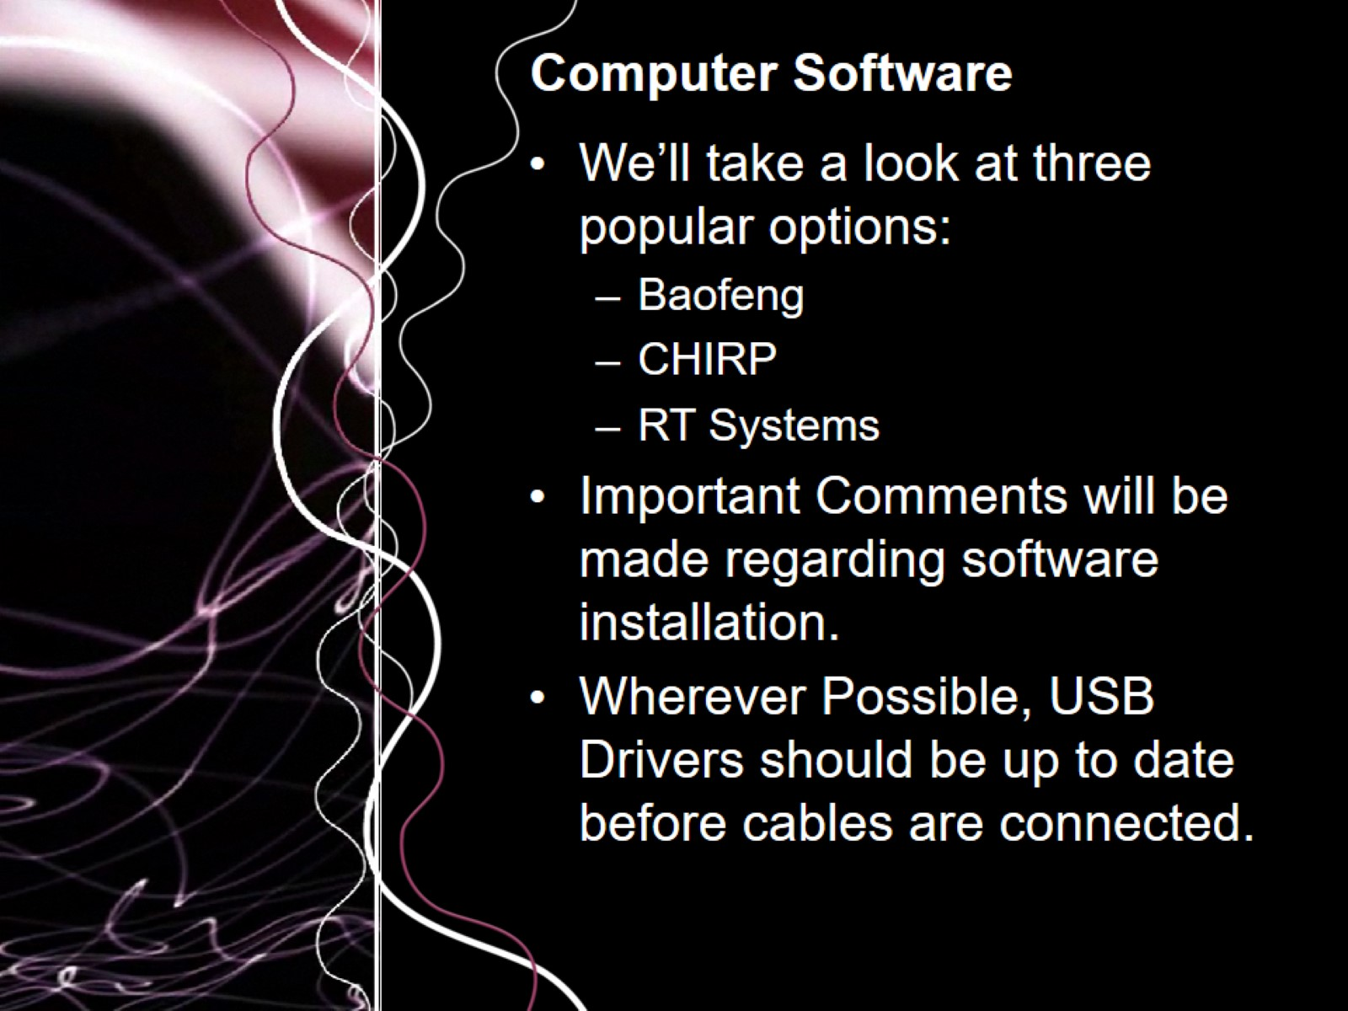
Computer Software

Slide 8
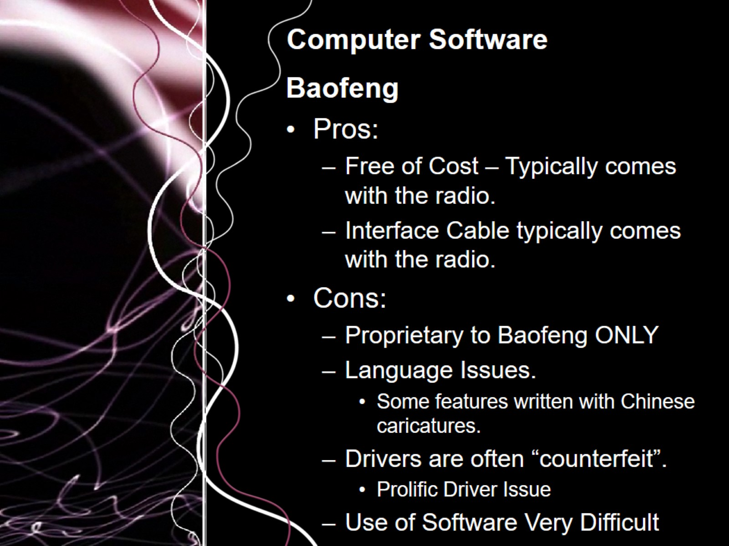
Computer Software

Slide 9
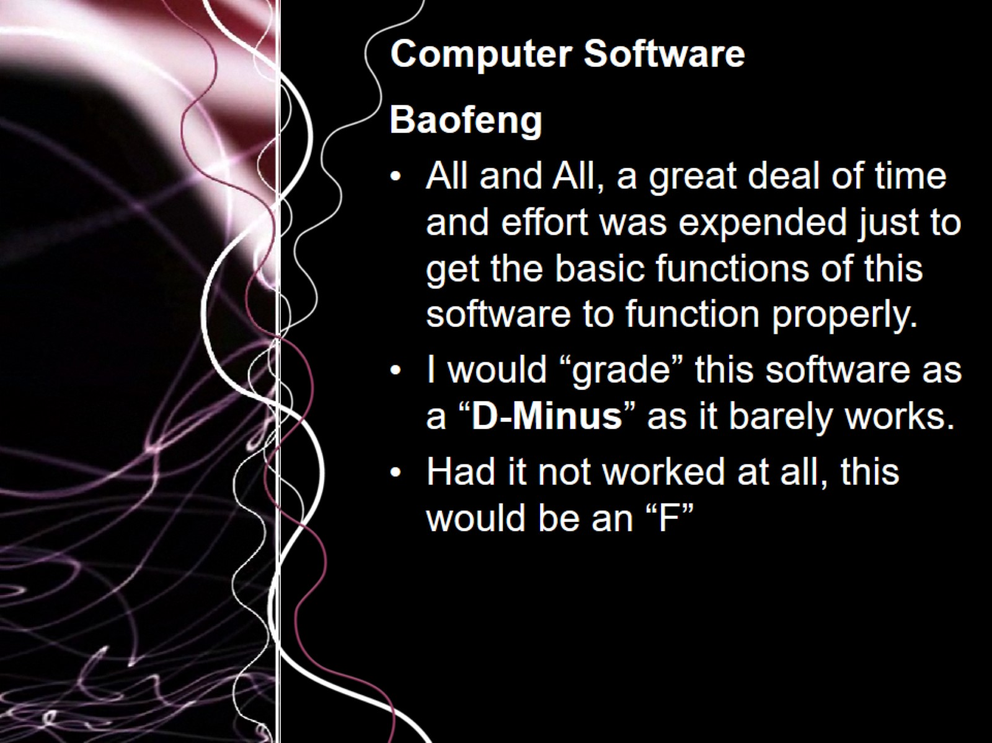
Computer Software

Slide 10
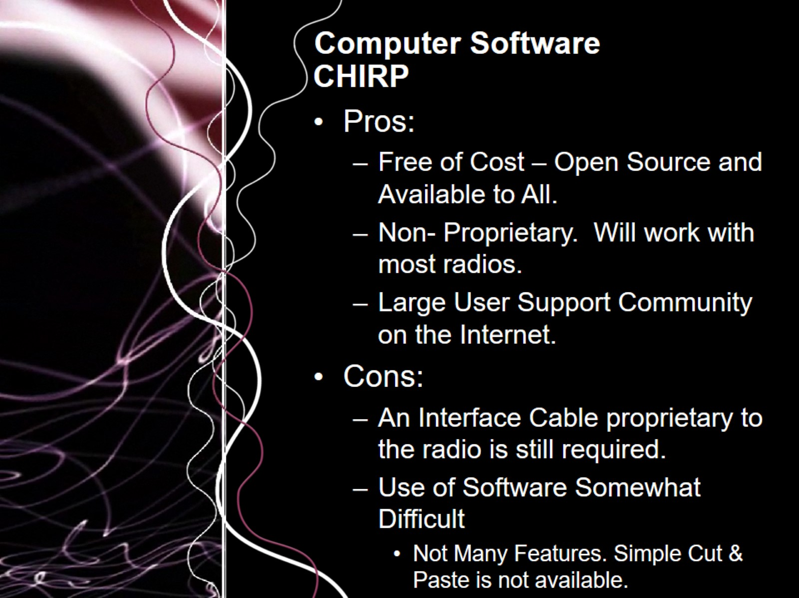
Computer Software

Slide 11
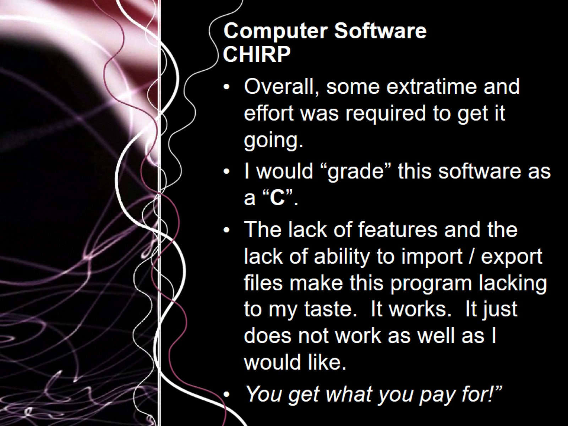
Computer Software

Slide 12
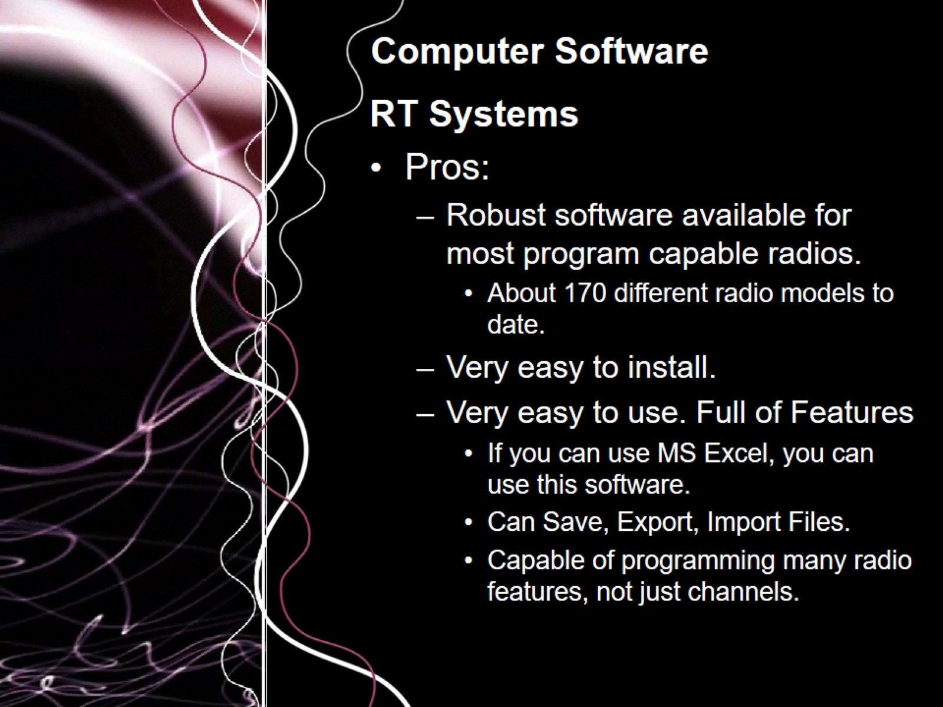
Computer Software

Slide 13
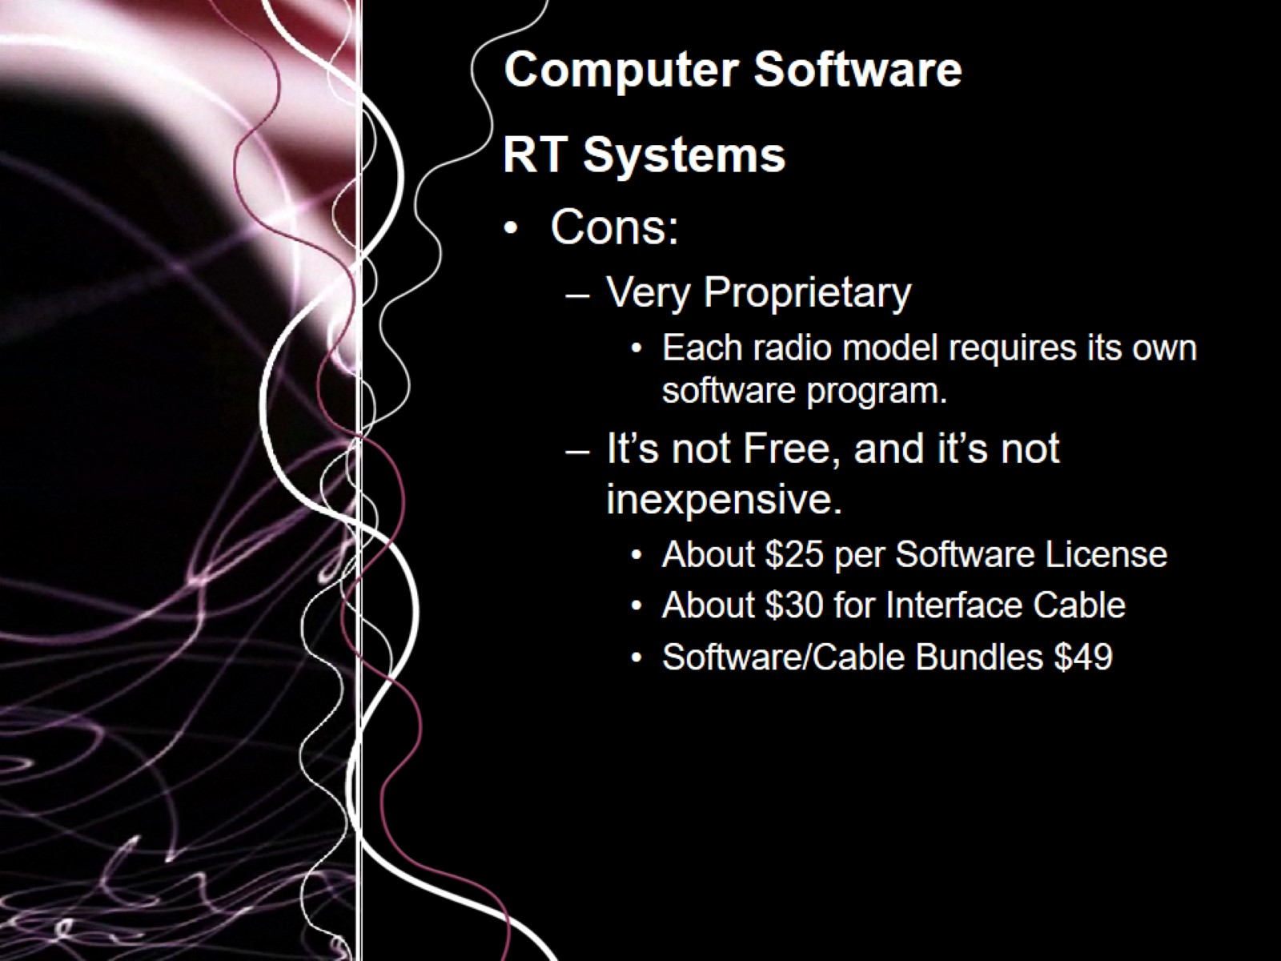
Computer Software

Slide 14
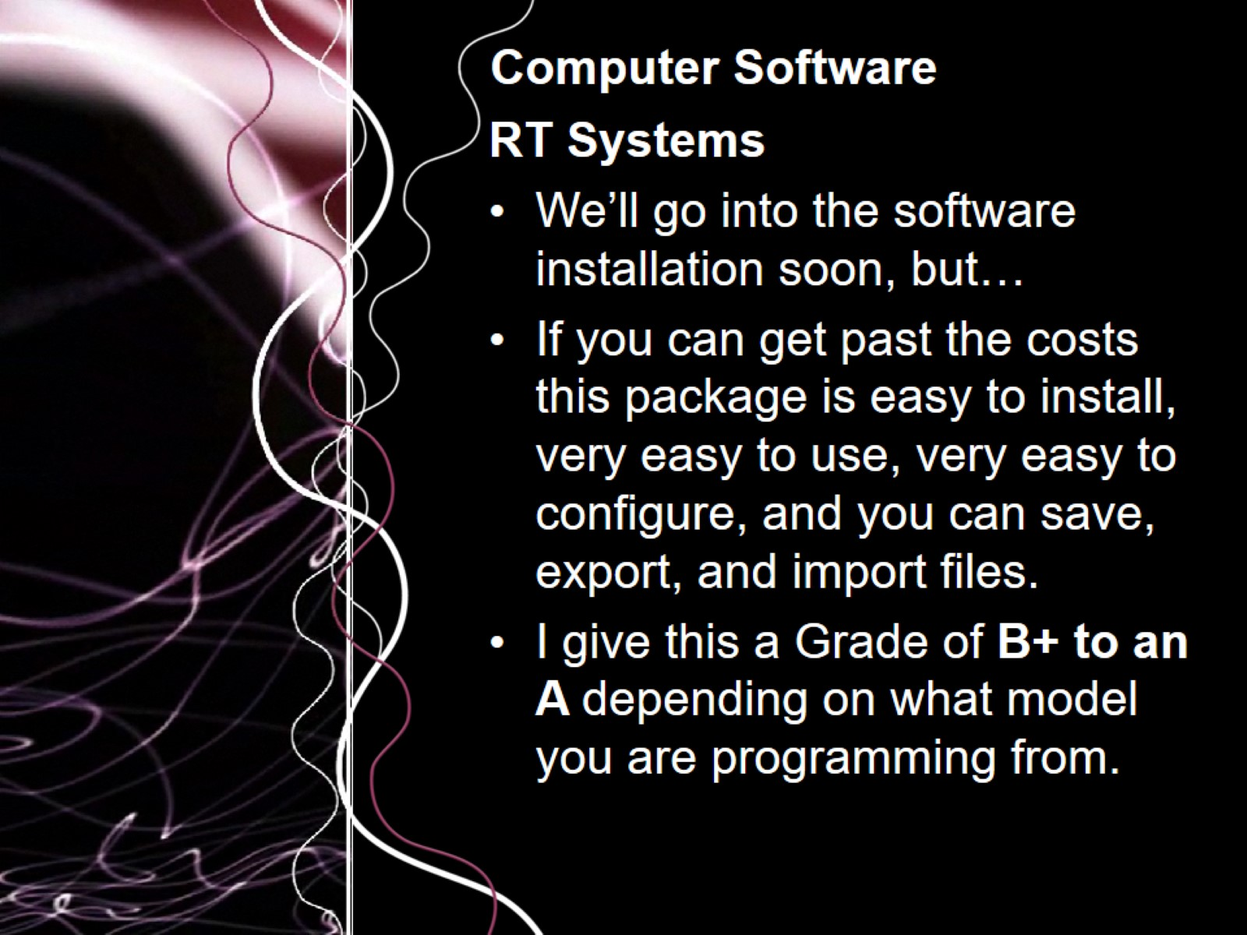
Computer Software

Slide 15
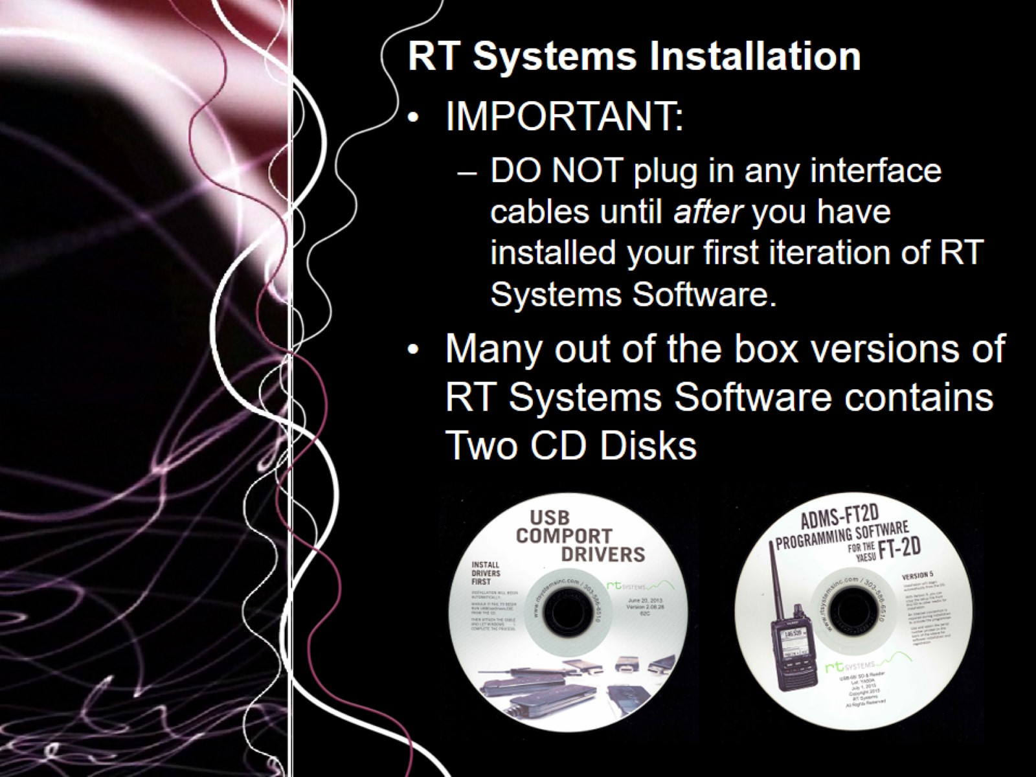
RT Systems Installation

Slide 16
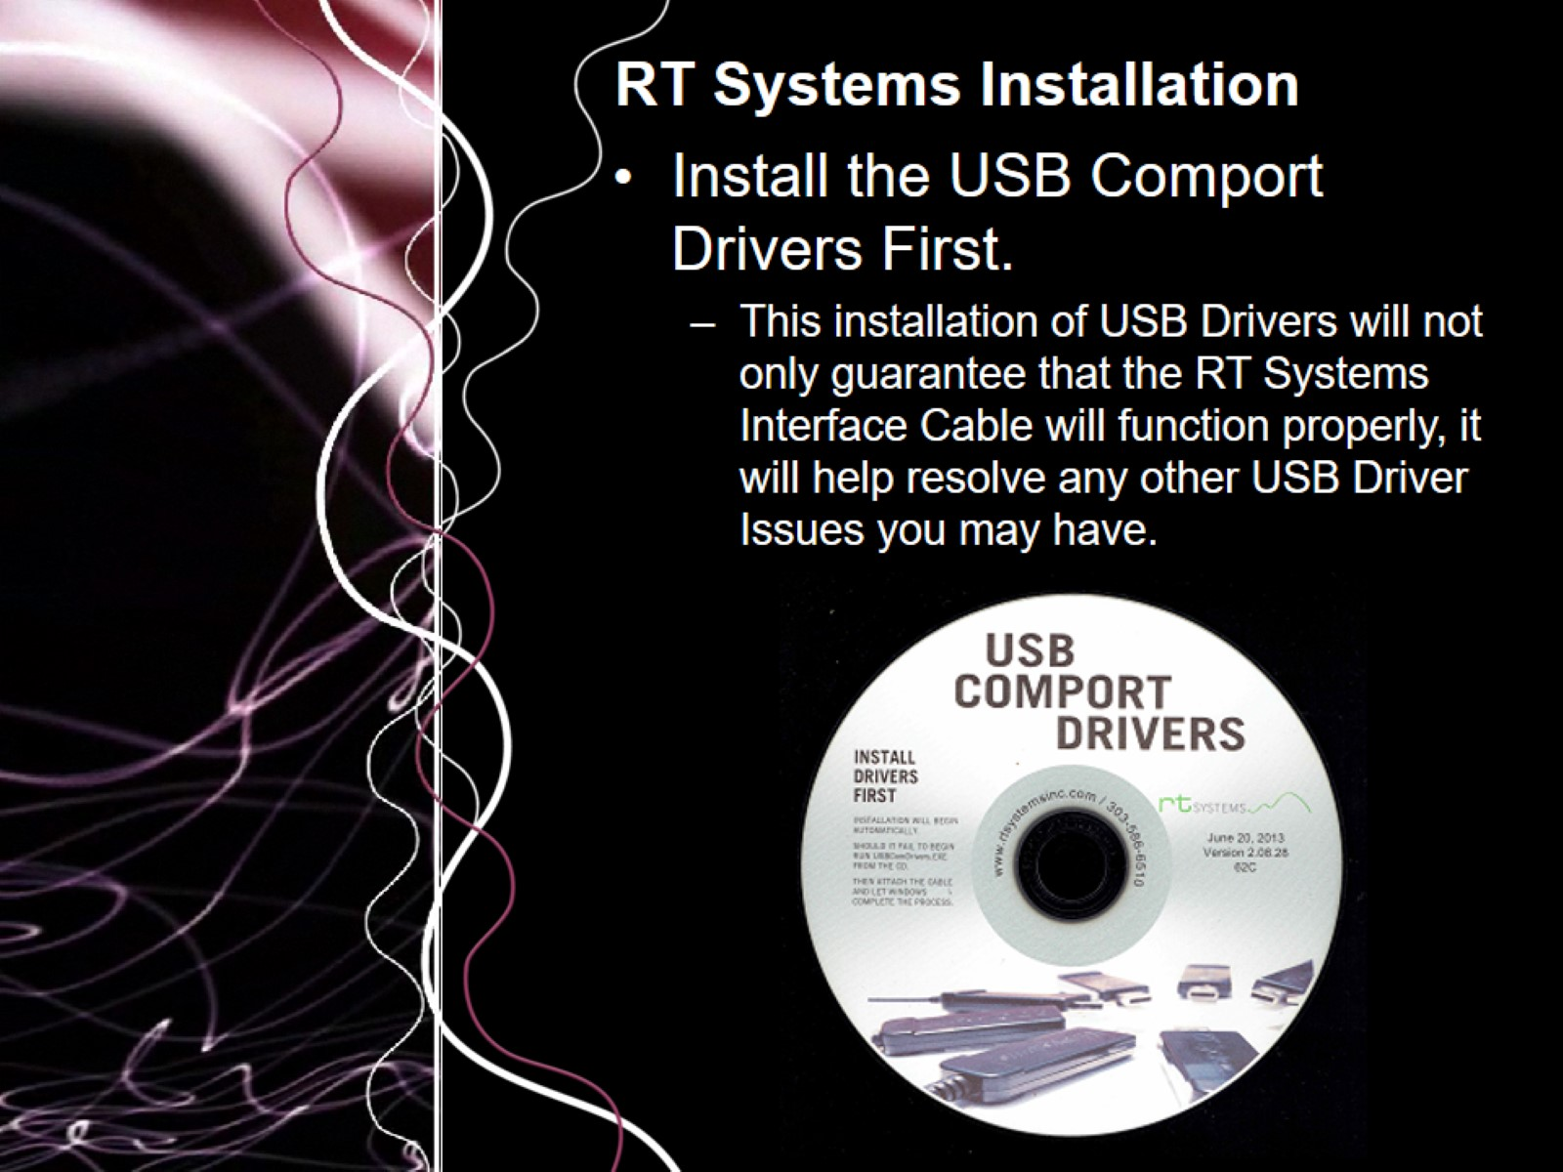
RT Systems Installation

Slide 17
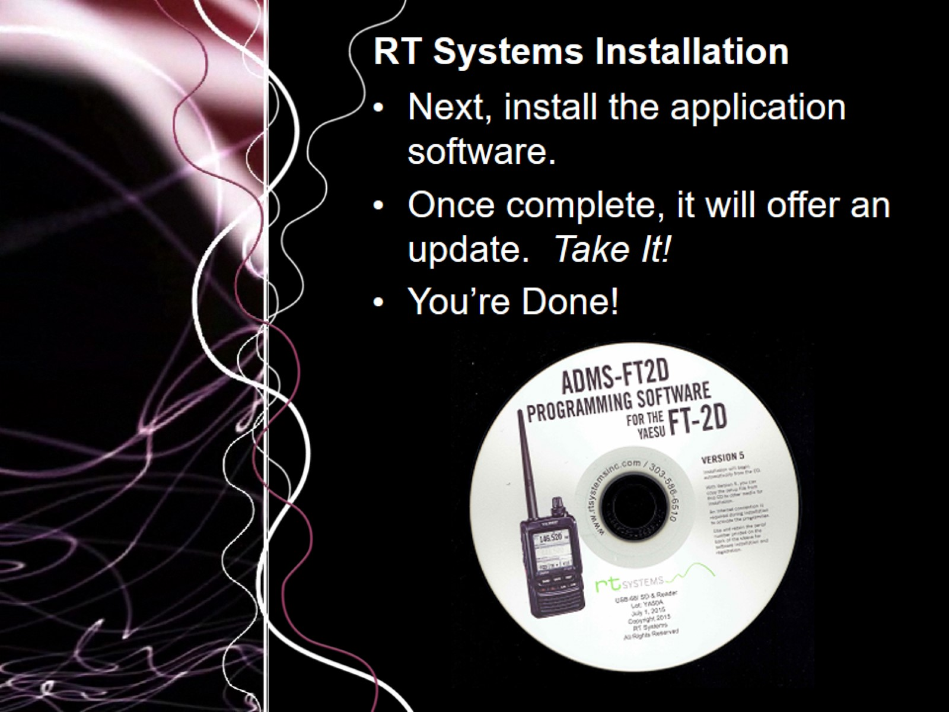
RT Systems Installation

Slide 18
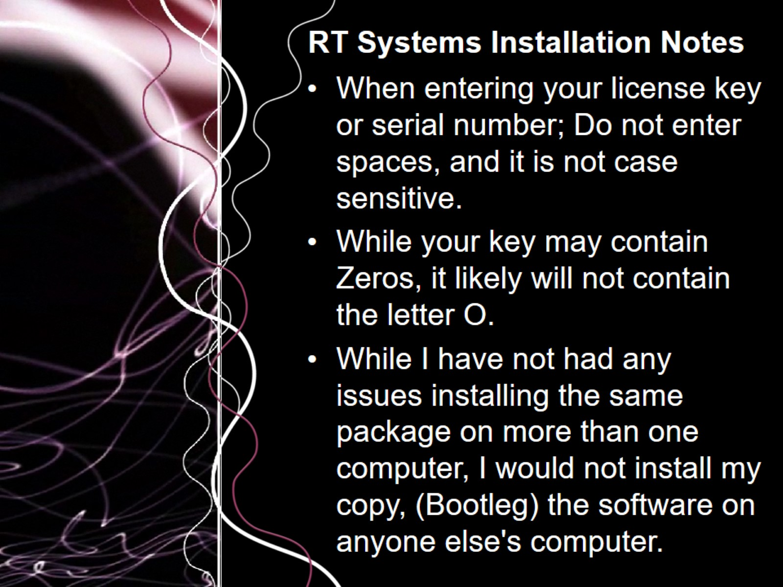
RT Systems Installation Notes

Slide 19
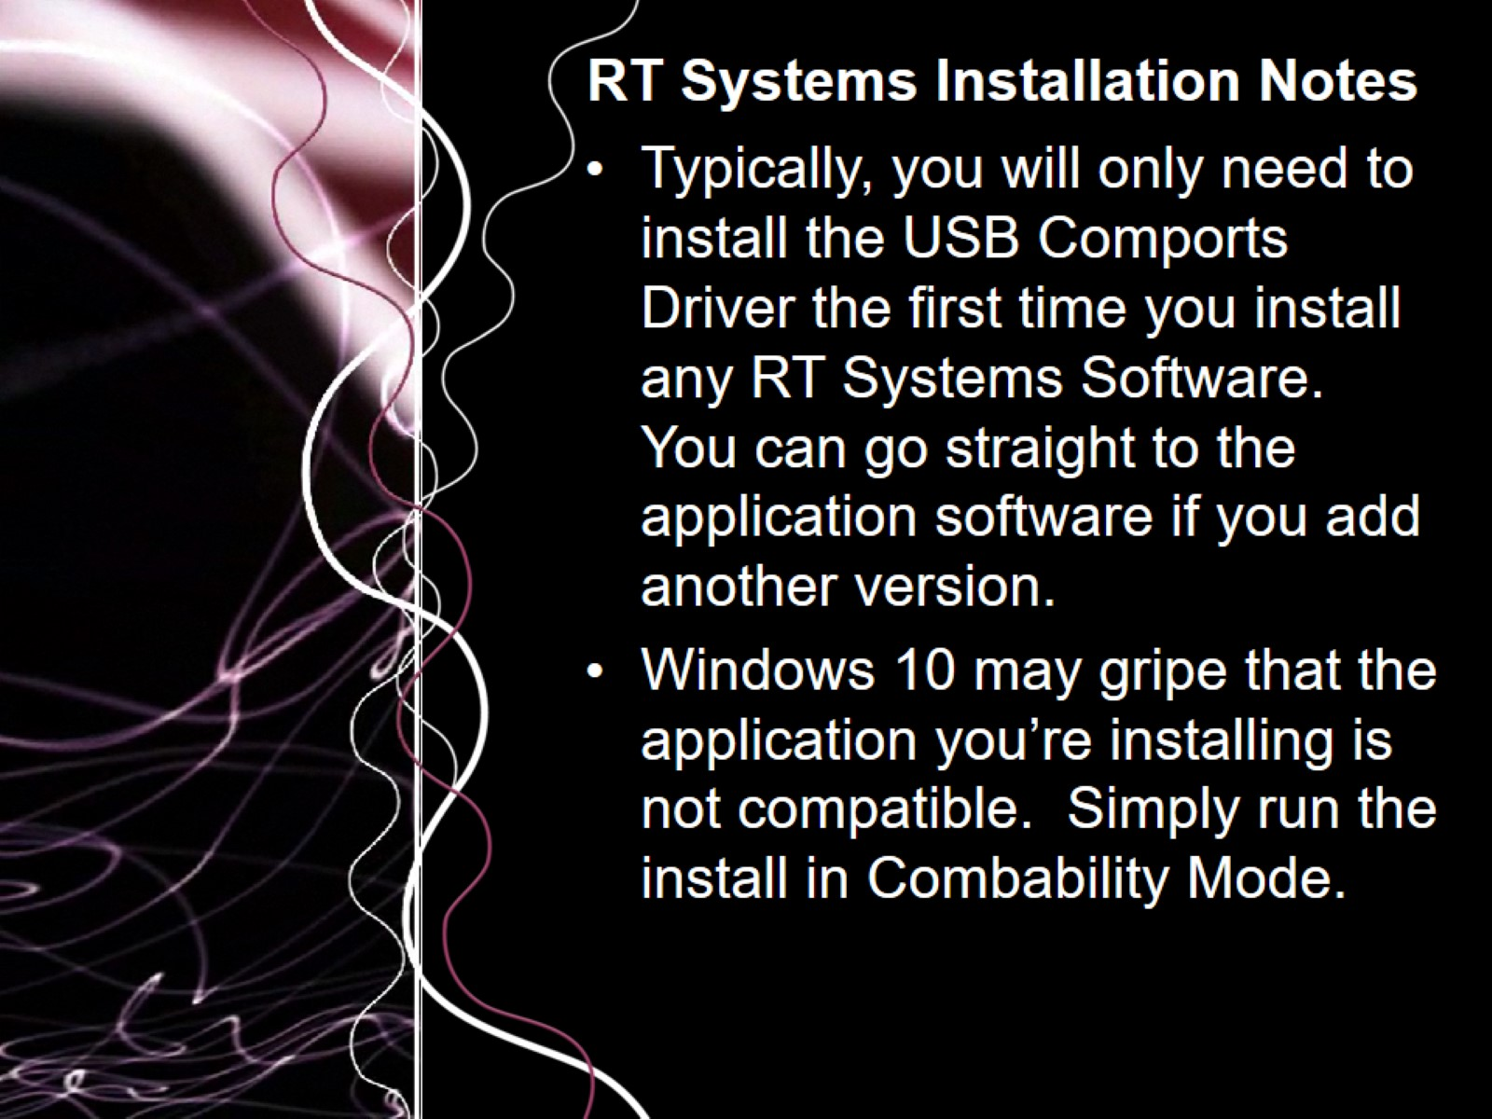
RT Systems Installation Notes

Slide 20
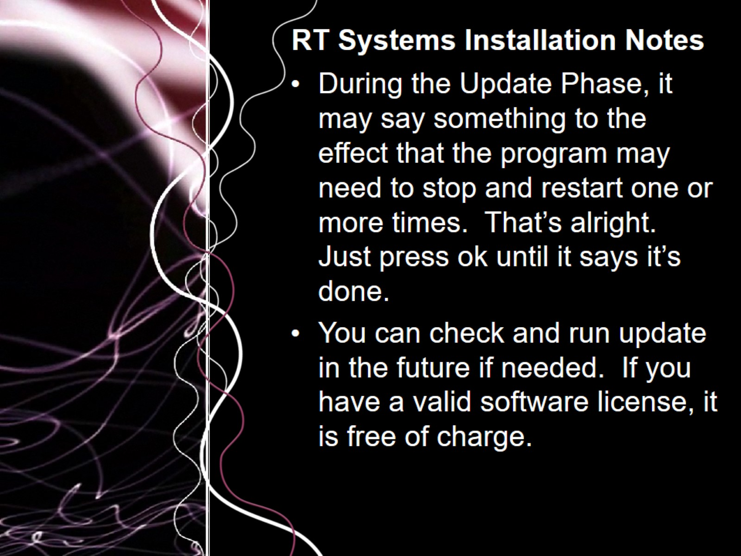
RT Systems Installation Notes

Slide 21
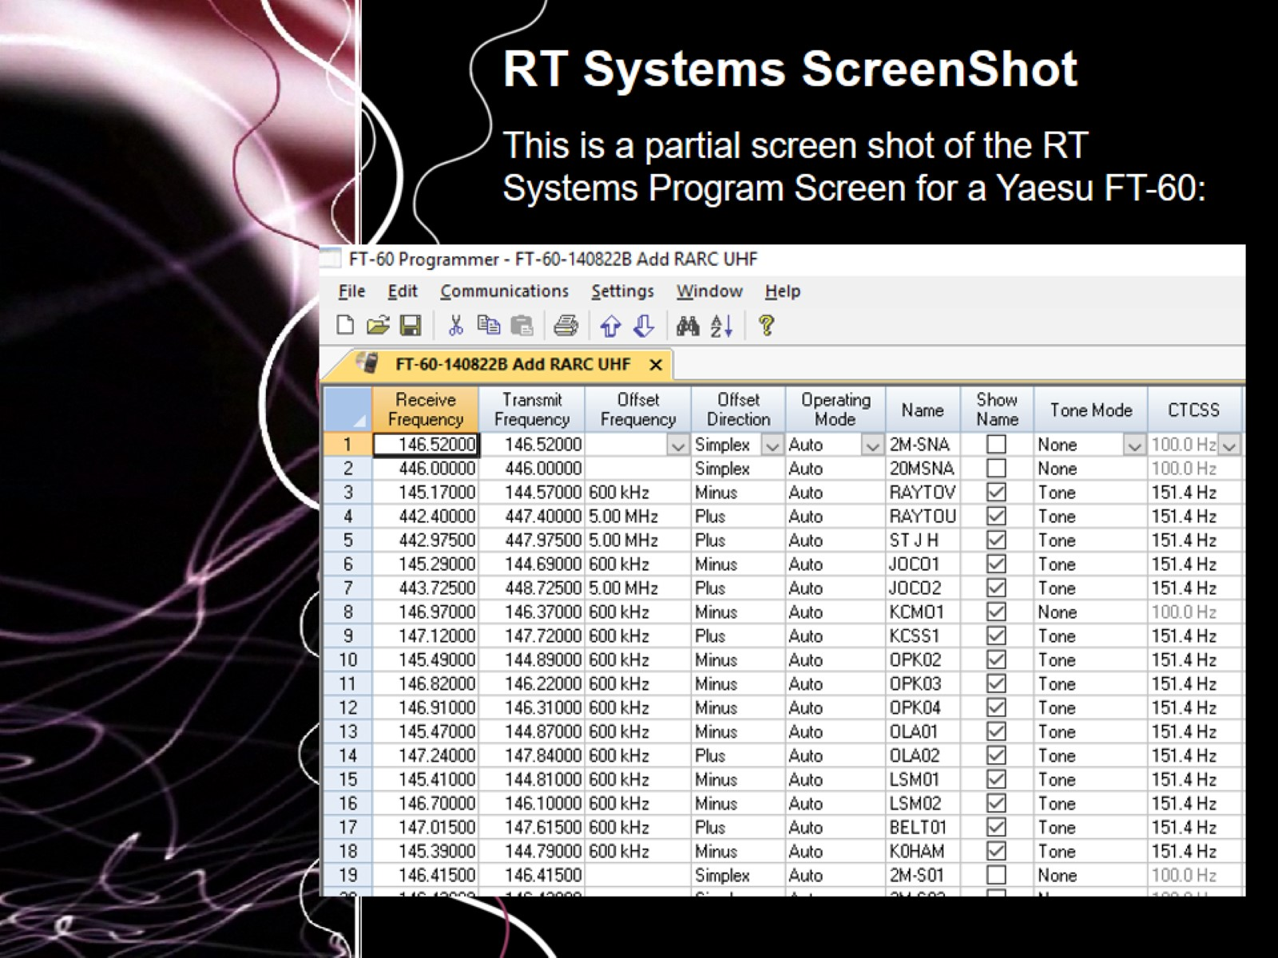
RT Systems ScreenShot

Slide 22
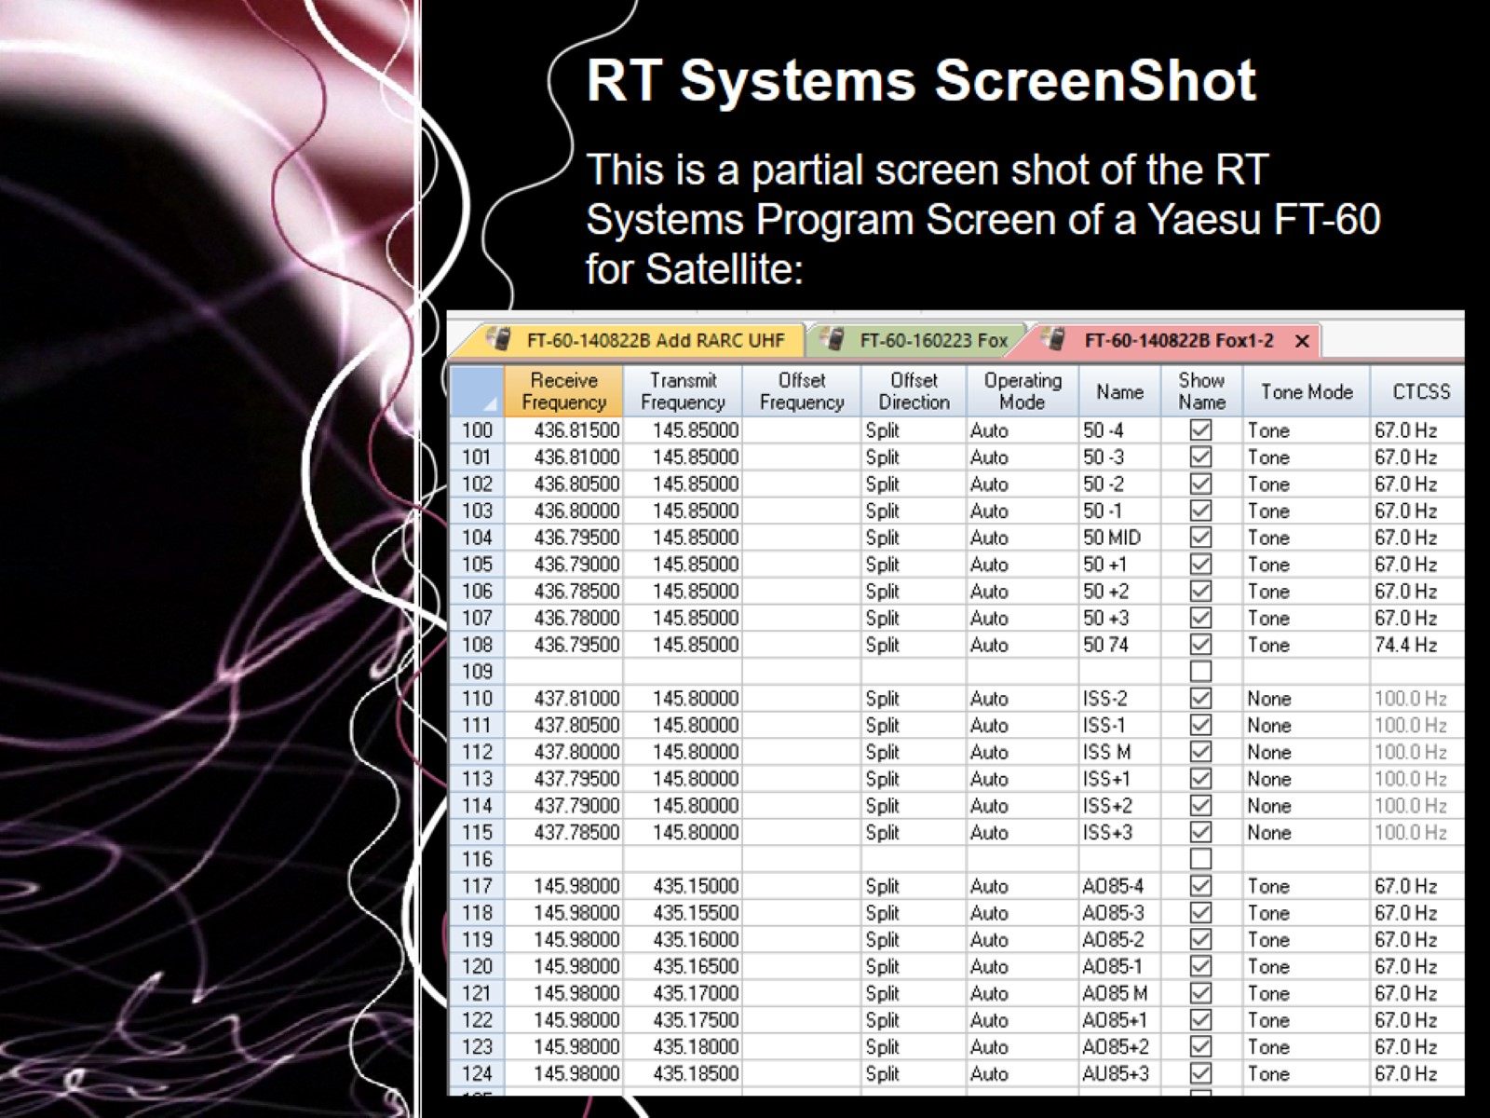
RT Systems ScreenShot

Slide 23
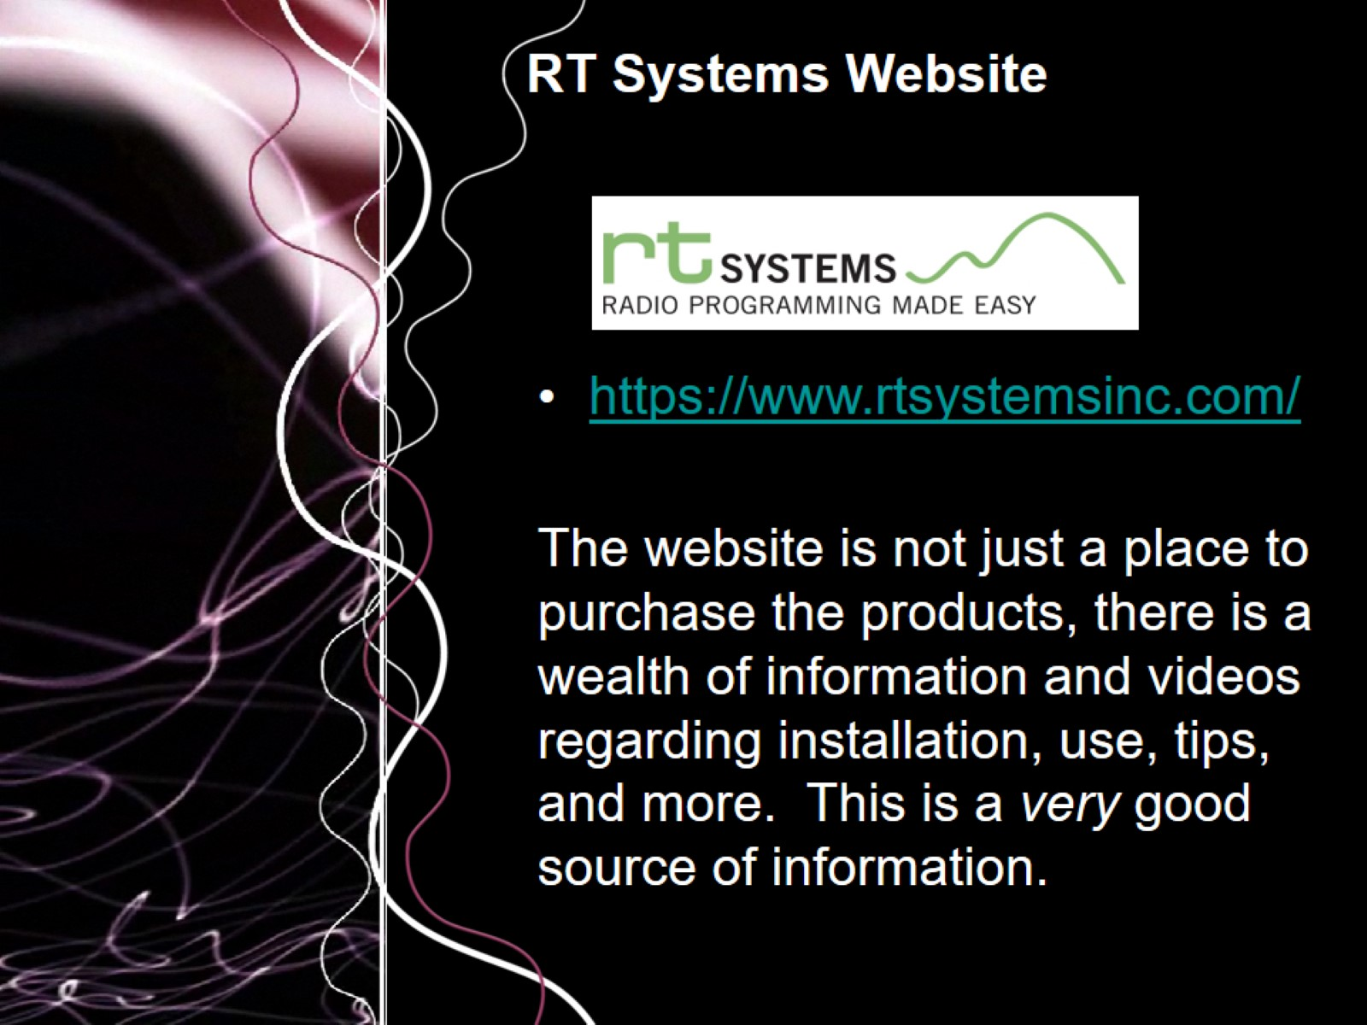
RT Systems Website

Slide 24

Questions and Answers

Slide 25


